Slide 1

ECOMARKET
TEAM 10
Akhil Raj Chatla – 1002170535
Rudviq Bhavsar – 1002091441
Kotagiri Satyanarayana Aravind Kumar - 1002126766
Prathik Chandra Hegde - 1002084424

Slide 2
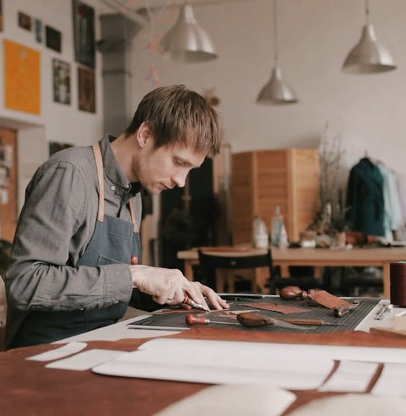
WHAT IS ECOMARKET?
EcoMarket: Handcrafted Materials is an innovative e-commerce platform born from a vision to bridge the gap between environmentally conscious buyers and skilled artisans specializing in sustainable, handmade materials.
Our project aims to provide a robust online marketplace where artisans can showcase their unique creations, and buyers can explore a curated collection of eco-friendly products

Slide 3

PLANNING
WORK BREAKDOWN STRUCTURE
COST ESTIMATION
GANTT CHART

Slide 4
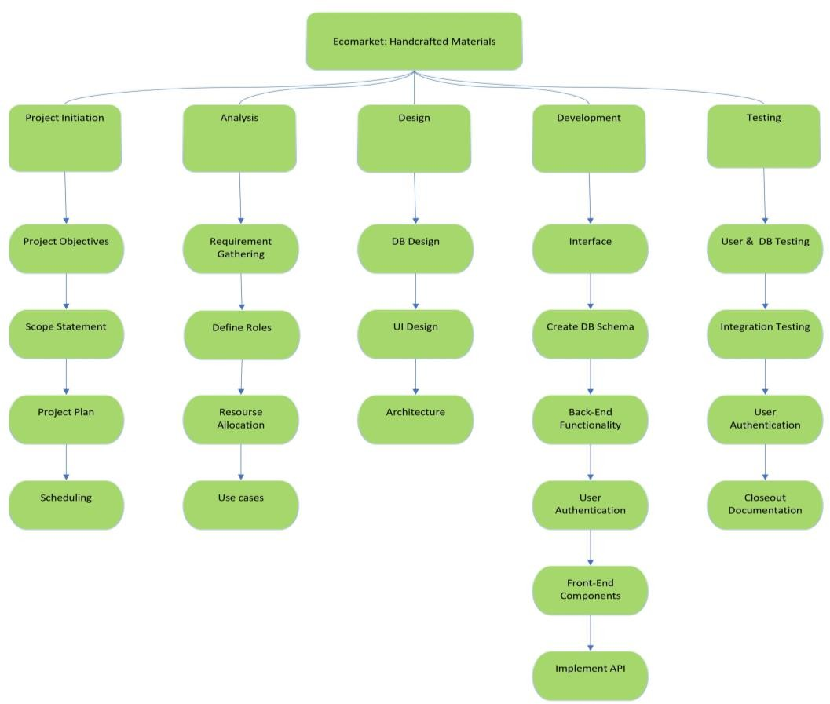
WORK BREAKDOWN STRUCTURE

Slide 5
COST ESTIMATION: COCOMO
The Basic COCOMO Model is used, and the type of software development mode is the Organic mode.
Constants for Organic mode software development:
The number of lines of code estimated is 4.37 KLOC.
Effort required, E = (2.4)(4.37)^{1.05} = 11.29059 person-months @ 11 person-months
Development Time, D = (2.5)(11.29059)^{0.38} = 6.28 months
Average Staff Size = E/D = 11.29 / 6.28
= 1.79 ( in person ) Productivity, P = KLOC / D = 4.37 / 11.29 = 0.387 K lines of code per person-month
Project type | a_{b} | b_{b} | c_{b} | d_{b}
Organic Mode | 2.4 | 1.05 | 2.5 | 0.38
E = a_{b}(KLOC)^{b}_{b} D = c_{b}(E)^{d}_{b}
where,
E - effort applied in person-months, D - development time in chronological months, KLOC - estimated number of delivered lines
of code for the project (expressed in thousands)

Slide 6
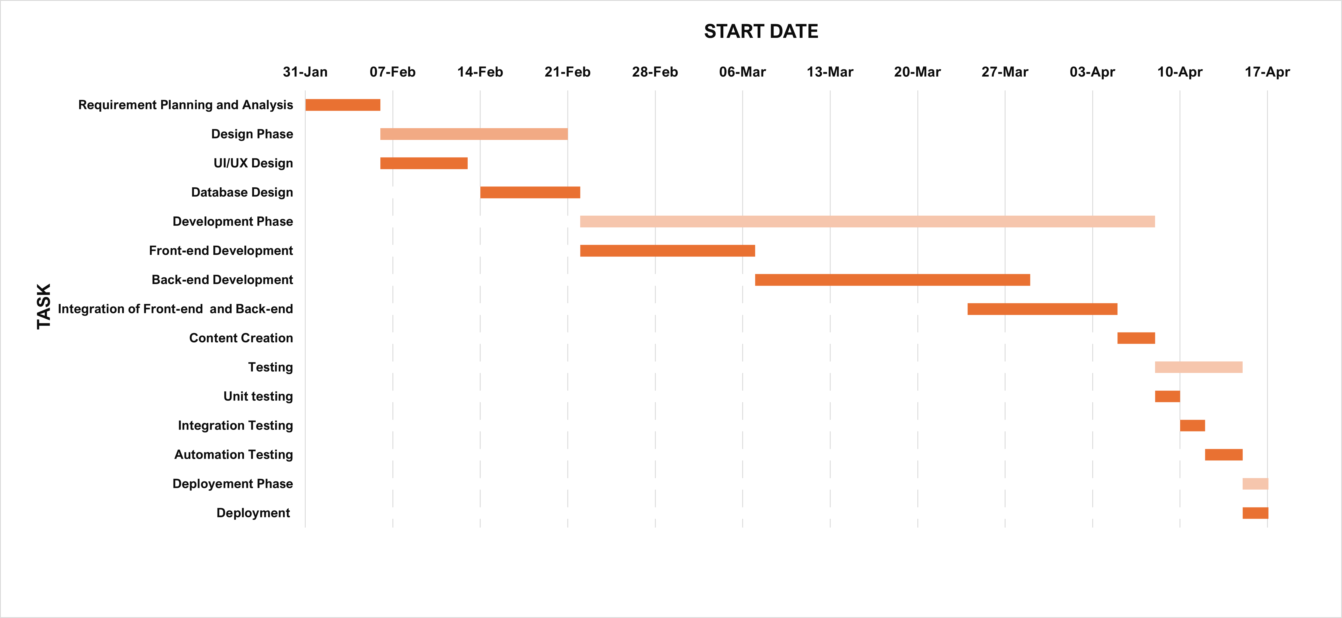
GANTT CHART

Slide 7
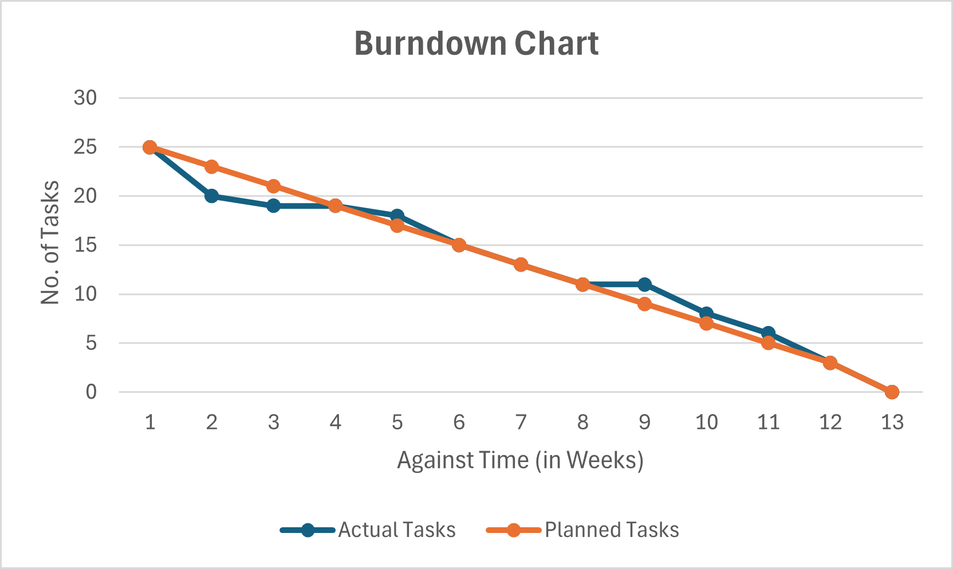
BURNDOWN CHART

Slide 8
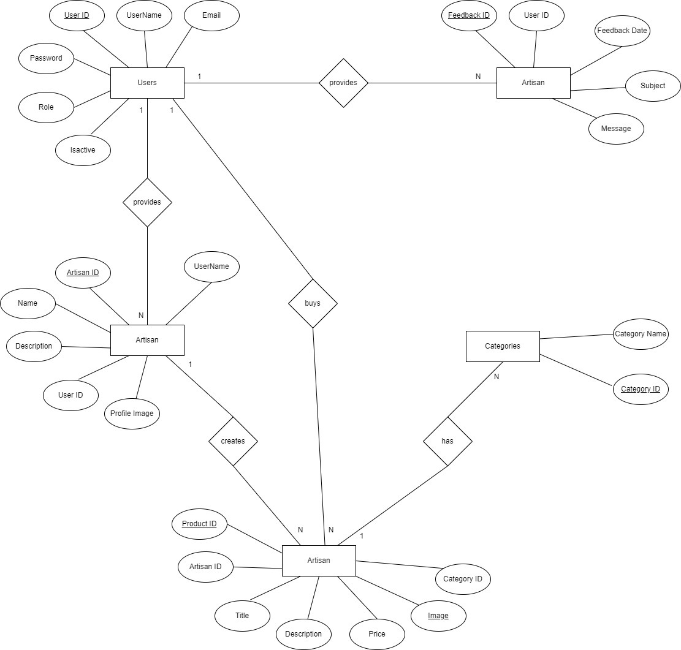
ERD
Feedback
Product

Slide 9
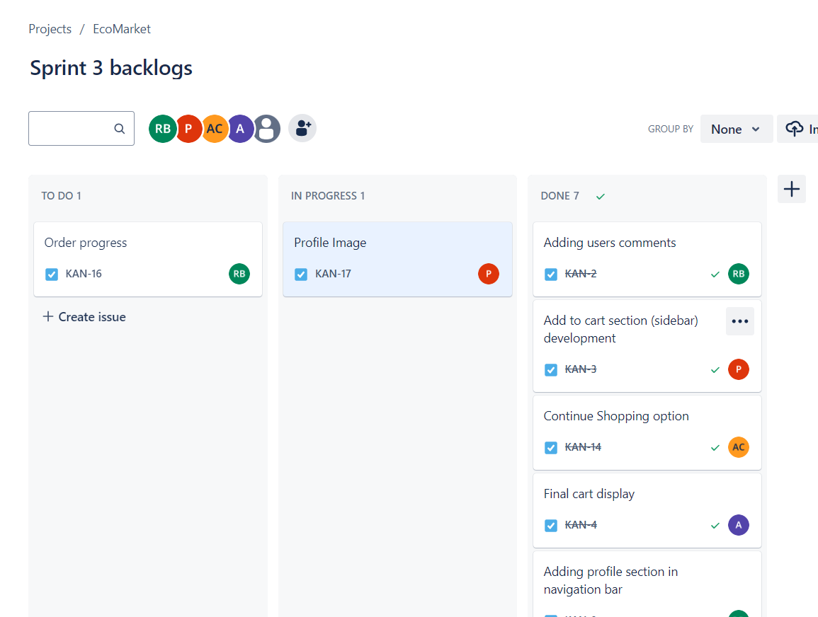
MANAGEMENT TOOL - JIRA

Slide 10
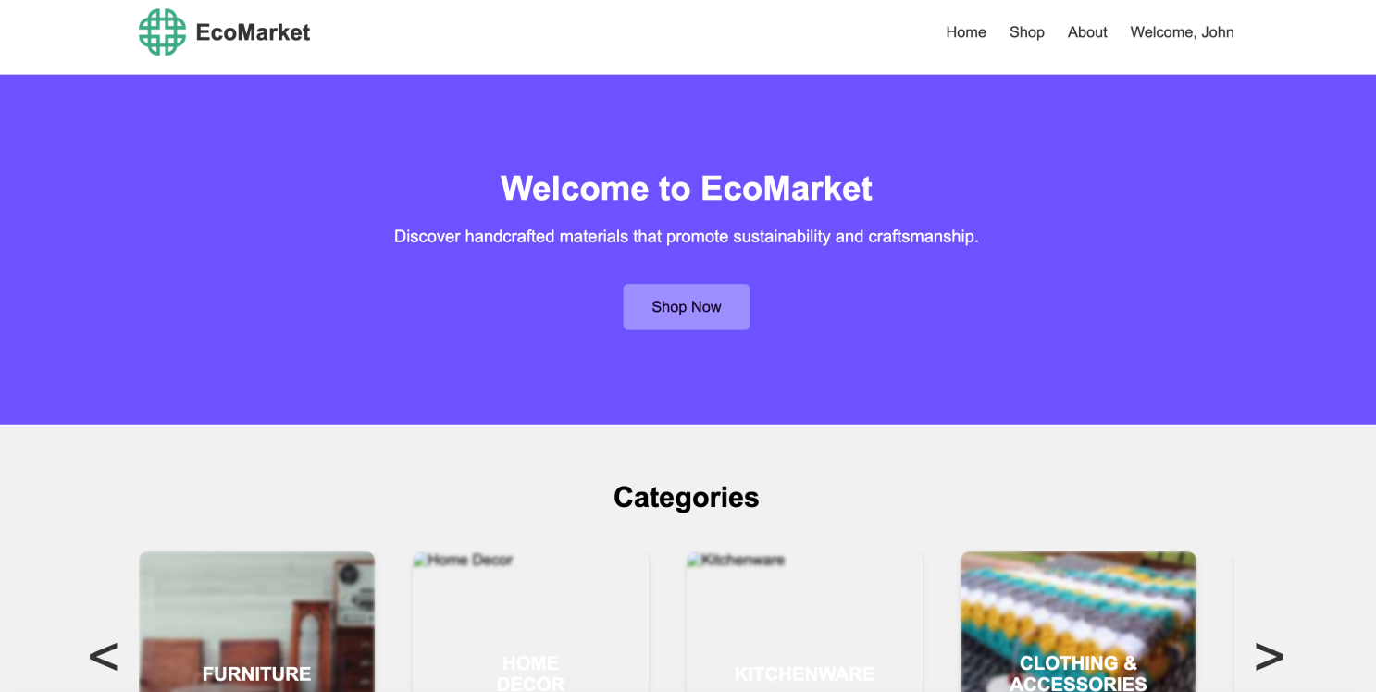
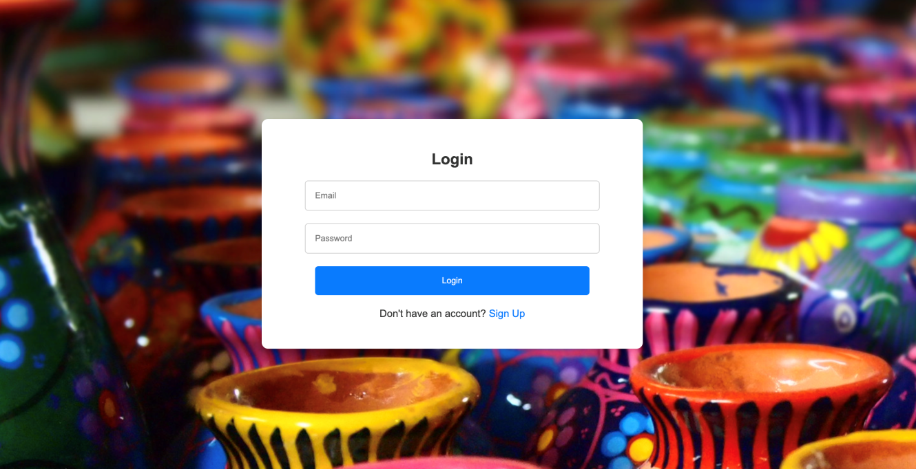
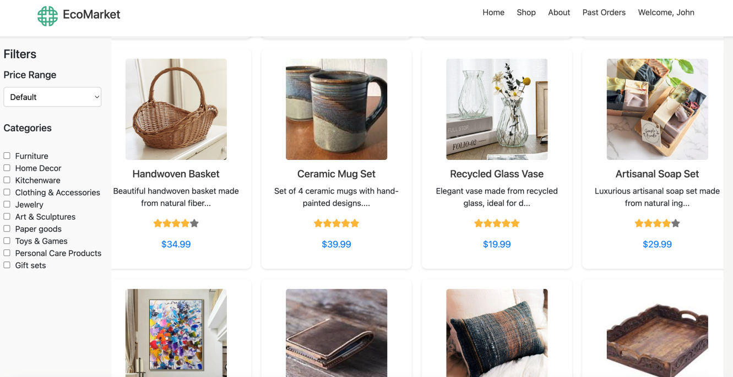
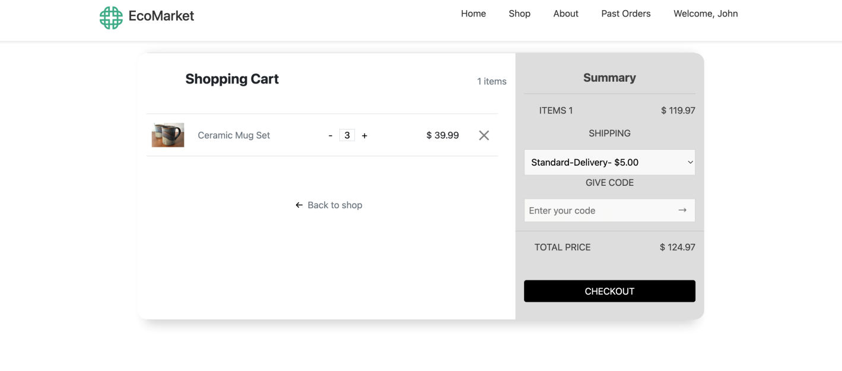
SCREENSHOTS

Slide 11
IMPLEMENTATION
Frontend Technologies:
HTML: The platform's structure and content foundation, providing a semantic and structured markup for web pages.
CSS (Cascading Style Sheets): Responsible for the visual styling of the platform, ensuring a cohesive and appealing user interface.
JavaScript: Enhances interactivity and user experience by enabling dynamic content, client-side validation, and asynchronous operations.
Backend Technologies:
PHP (Hypertext Preprocessor): The backbone of server-side scripting, facilitating user registration, authentication, and dynamic content generation.
MySQL Database: Stores and manages user data, course information, program details, and other critical data securely.
SQL (Structured Query Language): Used for efficient database operations, including data retrieval, insertion, and modification.
Interactivity and User Experience:
JavaScript: Enables client-side interactivity, including form validation, dynamic content loading, and responsive user interfaces.
Responsive Design:
Bootstrap Framework: Ensures the platform's layout adapts seamlessly to different screen sizes and devices, providing an optimal user experience on desktops, tablets, and smartphones.
Server-Side Operations:
PHP: Handles server-side operations such as form submissions, user account management, and database interactions.
MySQL Database: Stores user account details, course information, and other relevant data in an organized and efficient manner.
Server implementation:
We used XAMPP Software to run our web application on a local host web server.

Slide 12
RISK ANALYSIS
Risk Summary | Risk Category | Probability | Impact | Expected Value
Security - Authentication | Technical | Medium (20%) | Catastrophic ($10,000) | $2,000
Competition | Business | Low (5%) | Catastrophic ($15,000) | $750
Dependencies among modules | Technical | High (75%) | Catastrophic ($15,000) | $11,250
Latency in handicraft stock updation | Business | Low(10%) | Tolerable ($5,000) | $500
Issue in Payment Gateway | Business | Medium(25%) | Catastrophic ($12,000) | $3000

Slide 13
TESTING
FUNCTION | DESCRIPTI0N | Actual Output | Expected Output | Status
User Login | User enters the email and password and then login to go to his account | User enters the correct details and logs in. | User enters the correct details and logs in. | PASS
User Payment Page | User selects the products from the shop and adds it to the cart and when it tries to checkout and put card details to buy. | If the month entered is not proper then it shows a dialog box. | If the month entered is not proper then it shows a dialog box. | PASS
Stock Update | Atisan can update the stock of the items he made and enter how many more he has. | Enters a positive value and the available stock increases | Enters a positive value and the available stock increases | PASS
Dynamic Page View | There are 2 roles, one is artisan and one is user, so when both login the page shown is different for each role. | The artisan wont be showed past orders and any option to order the item | The artisan wont be showed past orders and any option to order the item | PASS

Slide 14
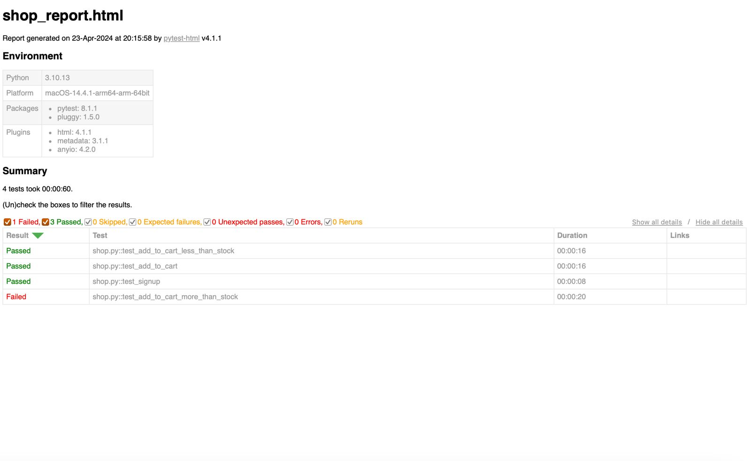
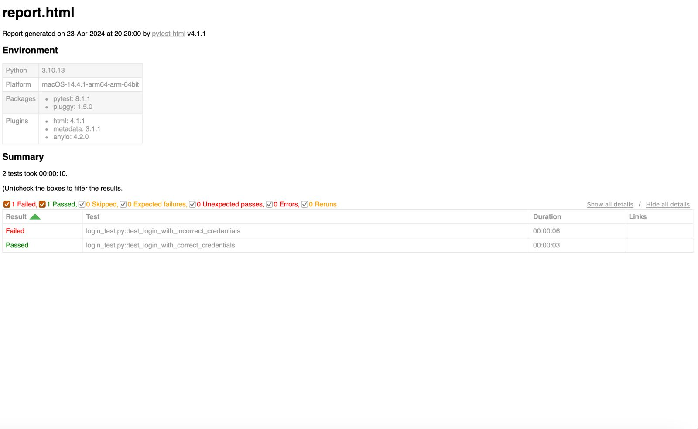
Automation Testing using Selenium:

Slide 15
MAINTAINANCE
Product Updates | Regularly update product listings with accurate descriptions, images, pricing, and availability to reflect the current inventory and offerings. | Corrective Maintenance
Ratings | Ratings from customers regarding their sustainability preferences, product satisfaction, and suggestions for improvement. | Perfective Maintenance
Regular Backup | Perform regular backups of website data and databases to prevent data loss in case of technical issues, cyber attacks, or server failures. | Preventive Maintenance
Inventory Management | Regularly update inventory levels, manage stockouts, and replenish popular items to prevent overselling and maintain customer satisfaction | Corrective Maintenance

Slide 16

FUTURE SCOPE
Artisan – Buyer Communication
Promotions & Marketing
Returns
Customized products
Product Recommendation

Slide 17

DEMO

